Slide 1
CENTRALIZED SYSTEMS
Done by
Skhembok Star Sohphoh
Roll No. 06

Slide 2
INTRODUCTION
A system where decisions for the system goal are made in a central mechanism and transmitted to executive components.
A Master-Slave based system where all information and commands are passed through the central unit.

Slide 3
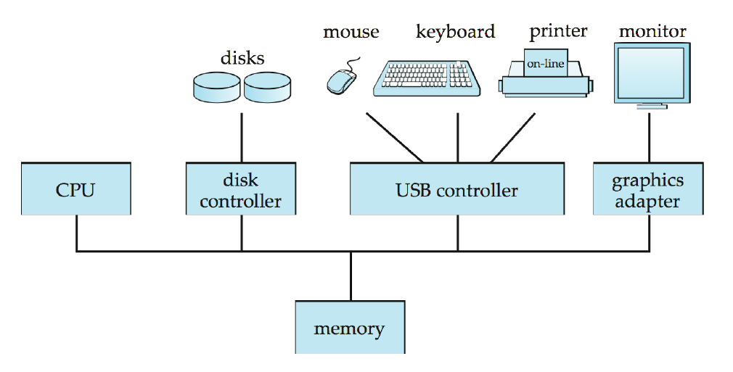
A Centralized Computer System

Slide 4
Centralized DBMS Architecture
In the DBMS Architecture, all processing is performed remotely on the computer system, and only display information and controls are sent from the computer to the display terminals, which are connected to the central computer via various types of communications networks.

Slide 5
Centralized Database Approach
Definition:
A centralized database consist of a single data server into which all data are stored and from which all data are retrieved. All the data reside at a single location and all application must retrieve all data from that location.
The centralized approach consist of a central server into which all forecast data are stored. At some predefined time, software on this central server requests data from each of the local data servers scattered throughout the country. These data are received, processed and stored, possibly at lower spatial and temporal resolution than the data from which it was derived.

Slide 6
Application Software
Central Data Server
Depicts the centralized Database systems.
Typical Examples:
DBMS itself was a centralized DBMS where all the DBMS functionality, application program execution and user interface processing carried out in one machine.
User Management Systems.
Central Documents Management Systems.

Slide 7
Advantages of Centralized Approach
Decreased Risk: With Centralized data management, all edits and manipulation to core data are housed and stored centrally. This mode allows for staunch controls, detailed audit trails, and enables business users to access consistent data.
Data Consistency: When data feeds are managed in a central repository, an organization can achieve consistent data management and distribution throughout its global offices and internal systems.

Slide 8
Advantages of Centralized Approach
Data Quality: A data-centric approach enables the establishment of a data standard across an enterprise, allowing organizations to make better business assessments.
Operational Efficiency: When one business unit controls an organization data centrally, the resources previously devoted to data management can be redirected back to core business needs.

Slide 9
Advantages of Centralized Approach
Single Point of Entry: By introducing single point of entry for data, this allows changes from data vendors to be implemented once, rather than in multiple instances.
Cost Saving: With data management centralized, costs attributed to vendor relationships are better controlled, minimizing any redundancy in market data contracts and their associated costs.

Slide 10
Disadvantages of Centralized Approach
Response Time: The size of a centralized database could cause data retrieval delays.
Equipment Cost: Depend on architecture, probably expensive if main frames are used.
Incremental Growth: Updating a centralized system is likely to be more difficult and more costly particularly if is it build on main frames. Large systems are typically more problematic to upgrade.
Single Point of Failure: Entire data is sorted at a single point (central server), if the data failed or corrupted then all the data will be lose.

Slide 11
Factors for Adoption of Centralized Approach
Data can be organized in single point, by introducing single point of entry for data Database Administrator can implement the data only once instead of in multiple sites.
Data consistency can achieve by introducing data-centric approach.
Centralized database approach is suitable for establishment of data standards across an enterprise.
For batter security purpose Centralized database approach is suitable.
For quick efficient searching Centralized approach is good one.
For controlled access to the database repository.

Slide 12
Conclusions
As prices of hardware declined, most users replaced their terminals with PCs and workstations. At first these were used to how they would use a terminal, so that the DBMS itself was still a centralized DBMS, in which all the DBMS functionality, application program execution, and user interface processing were carried out in one machine.
Gradually, DBMS systems started to exploit the available processing power at the user side, which led to client/server DBMS architecture.

Slide 13
References
https://www.ukessays.com/essays/information-technology/a-centralized-database-approach.php
http://www.igi-global.com/dictionary/centralized-system/3590

